Slide 1

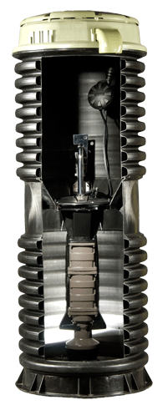

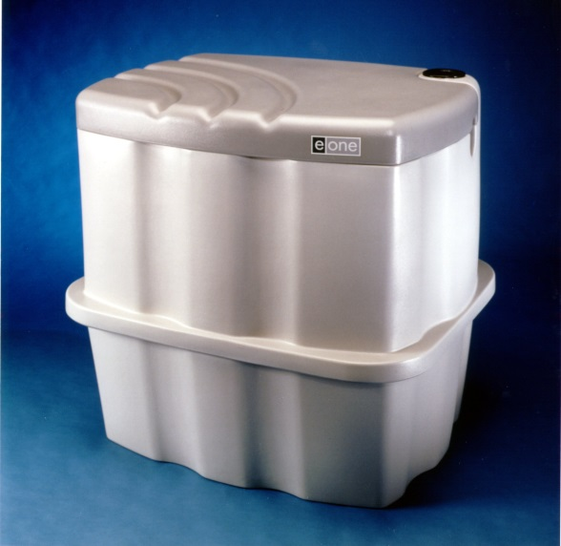
Environment One
Now representing E/One in the six New England States.
D Series and IH indoor Certified Installation

Slide 2
Contents
Overview
  Pressure Sewers
  Pump Options
Inspection –
  Before you begin
  Keys to proper Installation
Bedding
Ballasting
Installing/Placing the Station
Piping
  Inlet
  Discharge
Backfill
Height Adjustment
Indoor Pump
Electrical
  Indoor Panel
    Wiring
  Outdoor Panels
    Wiring
Startup Inspection

Slide 3
Pressure sewer overview- System
Pressure sewer pumping has been a viable means of collecting and transporting wastewater for over 46 years.
Environment One Corporation developed the worlds first grinder pump.
Today E/One serves over two million end users in over 43 countries.
Every day E/One connects 150 homes to sewer systems word wide.
Projects range from single pump applications to over 16,000 pumps. Mornington Peninsula for South East Water, Australia

Slide 4
Environment One corporation
Niskayuna, NY (Suburb of Albany) for 50 years
Distribution through designated supply/channel partners
E/One is engineered product/system
Local representation through F. R. Mahony & Associates, Inc., Rockland, MA for 41 years.
  Complete design, sales and service support in the New England Region

Slide 5
Why pressure sewer?
Pressure Sewers offer a wide range of benefits.
  Lower cost compared to gravity
  Easier to install than gravity
    Shallow trenches
    Small diameter pipelines
    Less disruption to existing utilities
  Lower operating cost than gravity and pump stations
  Eliminate inflow and infiltration

Slide 6
Overview
D series stations
E/One’s most flexible product line
Capacities of 70 gallons to 500 gallons
HDPE or fiberglass tanks
Flood configuration available
1 to 4 pumps
  Depends on tank
Grade line
1.25” discharge
4” inlet
1 hp, 1725 rpm
SPD Pump

Slide 7

Overview
Indoor series stations
IH -091

Slide 8
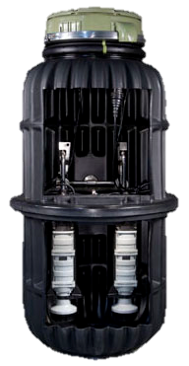
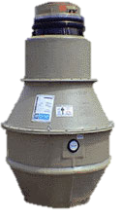
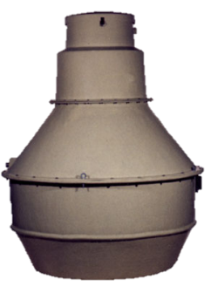

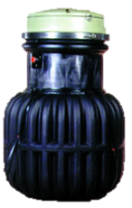
Overview d series stations
DH151
DH 152
DH272
DH 502

Slide 9
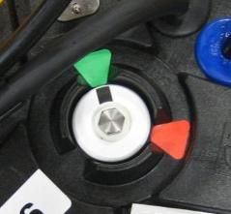
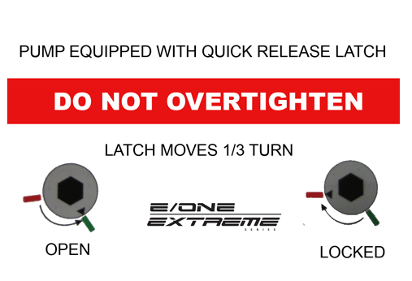
Overview
D series stations
Sealed access to wet well for safety
Core sits on a “deck” in the transition of the tank
Uses a latch to lock the core in place
  Lock & unlock with core wrench
Sticker under station lid shows locked and unlocked positions

Slide 10
Before you begin- inspection

Slide 11
Inspection – Before you begin
What to look for
  Check tanks for cracks, broken discharge connections, seam separation, etc.
  Check Panel containers for external damage to the box.
  Check Pump containers for external damage to the box
Liability
  Once you sign for it, you limit your ability to submit a claim for damages to the trucking company
Storage
  Cores, which may be shipped separately in some models, are stacked on pallets in cardboard boxes. Store cores in a dry area.

Slide 12
Inspection – Before you begin
What to look for on site
  Verify house plumbing elevation
  Does it match the station height and elevations?
    Locate discharge at foundation
    Measure to liquid level in existing septic tank
    Follow design plan elevations – when provided
  Verify house plumbing discharge
    Line size
      Typical pump inlet is 4-inch
    Pipe material
      Standard grommet inlet for SCHEDULE 40 PVC
      Alternate Inlet grommet SDR 35 PVC
  Verify power supply and capacity

Slide 13
Keys to Proper Installation
Do not drop, roll or lay stations on their side with the core installed in the basin
Place the unit on a 6” level bed of naturally rounded ¼‘” to ¾” aggregate stone
The unit must be leveled and the wet well should be filled with water to the bottom of the inlet to help prevent shifting
The proper amount of ballast (either poured in place or pre-cast) is mandatory for the soil conditions present
Proper backfill and compaction are mandatory
The basin must be properly vented
Finished grade line to be 1 to 4 inches below lid and slope away from the station

Slide 14
Site work – bedding and ballast

Slide 15
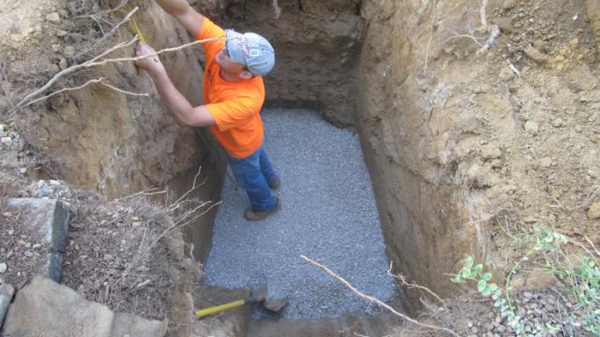
Bedding
Bed your hole with a minimum of 6” of ¼” to ¾” aggregate stone

Slide 16
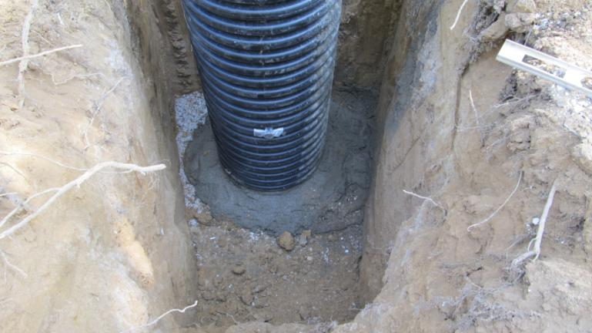
Ballasting
Poured in Place
Ballast poured in place

Slide 17
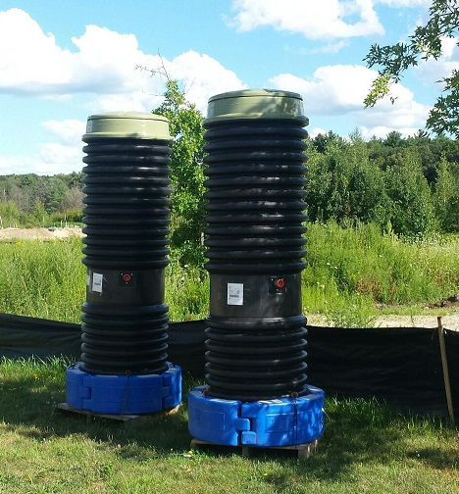
Ballasting
Precast Forms
Assemble on site or prior to delivery.
Provides 120% of ballast needs
Reduces installation & dewatering time and costs
Reduces inspection time and cost
Installs in minutes so you can backfill immediately
Bal-Last® Precast Forms- WhenI ncluded in Scope of Supply
www.interlockingballast.com

Slide 18

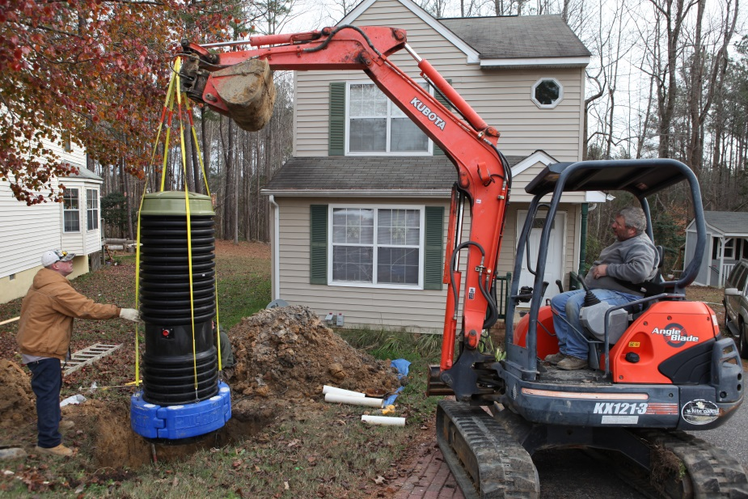

Ballasting
Precast Forms

Slide 19
Proper station lifting
Precast ballast must have 4 rebar hooks spaced 90 degrees apart. Non-precast tanks can be strapped around the access-way

Slide 20
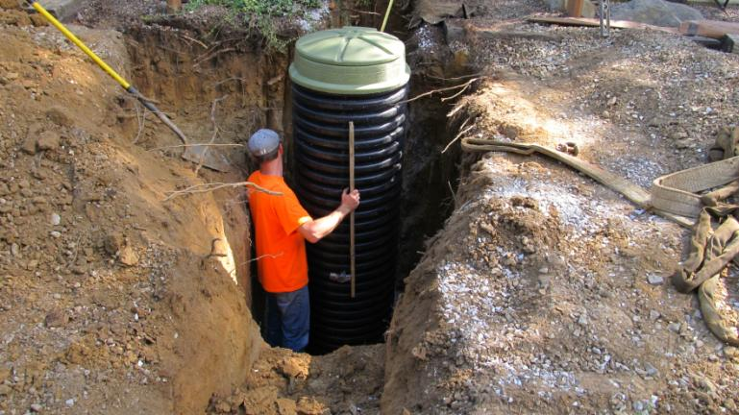
Level the station
Ensure that the station is level

Slide 21
Inlet and discharge piping

Slide 22
Pipe materials - classification
Discharge Pipe
  Outdoor Pump use:
    1-1/4 inch SDR 11 HDPE PE4710 rated to 200 psi
  Indoor Pump use:
    SCHEDULE 40 PW or SCHEDULE 80 PVC
Valves and fittings
  Avoid brass waterworks fittings that are not rated for sewage application.
  De-alloying- corrosion
  Avoid ball check valves, spring loaded valves, waterworks brass.
  Clogging
Inlet Pipe
  Typical inlet 4-inch SCHEDULE 40DWV PVC
    6-inch grommets are available (option adder)
  Options
    SDR 35 (Thinner wall)
  Additional Inlets
    Core in tank at 45 degree increments. Only in the smooth wall section.

Slide 23
Pipe bedding

Slide 24
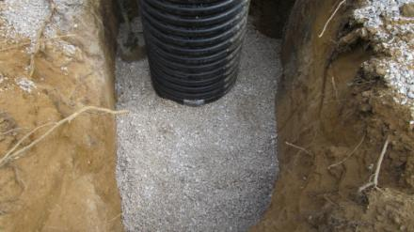
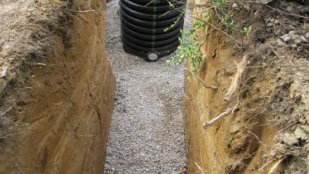
Backfill up to piping
Due to some native soil conditions, it is recommended that you backfill with Class 1 material up to the discharge and inlet piping before you install them.

Slide 25
Inlet Pipe
Standard 4” SCH 40 pipe grommet supplied
  Optional 4” or 6” SDR35 or 6” SCH40 pipe grommets are available
Pipe end should be chamfered and lubricated with a soap solution
Mark insertion depth of
3 ½” on O.D. of pipe
  Do not exceed during installation of pipe into grommet

Slide 26
Inlet Pipe
Pipe should enter station straight and not at an angle
If pipe is being stubbed out, it should be a minimum of 5’ with a glued cap to seal the end
The line should be bedded with crushed angular stone to minimize pipe deformation
The bottom half of the line should be bedded at a minimum. The entire pipe is preferred

Slide 27
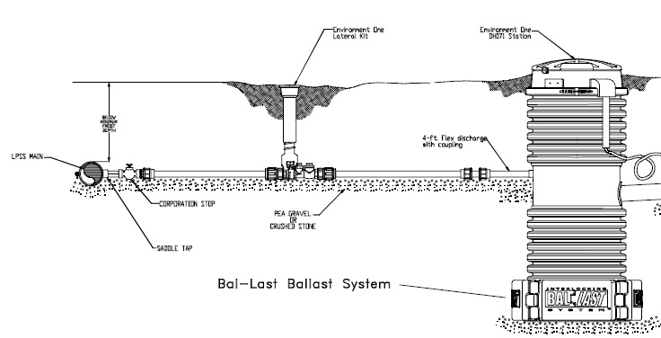
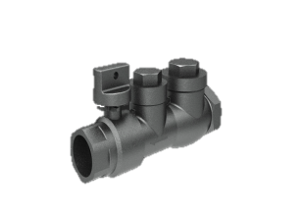
Discharge Pipe
It is HIGHLY recommended that a curb stop/redundant check valve be installed between the pump discharge and the street main.
We recommend a sewage rated, pressure rated, full-port check valve

Slide 28
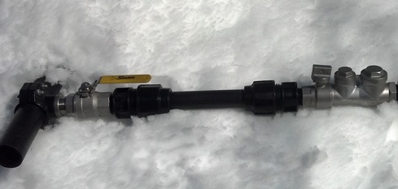

Connection to lateral
Typically service laterals are capped off with temporary plug.
Verify the lateral curb stop is closed before removing the temporary plug.
Clean threads and install ‘Compression’ X Male IPT adapter with Teflon tape and/or paste as thread sealant.
Install new service pipe (1-1/4 inch SDR 11 HDPE preferred) into ‘Compression’ fitting. (See following slides)
Definition: Compression adapter = Split ring, restrained, bell and gasket fitting.

Slide 29
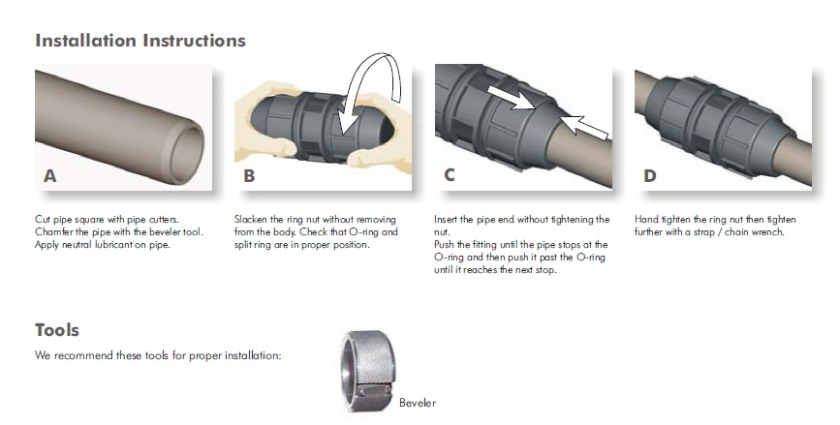
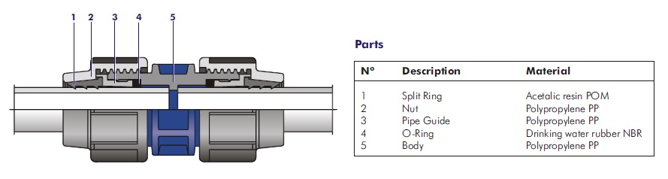
Discharge Pipe – ‘Compression’ coupling
Insert Pipe past O-ring ‘4’ until pipe hits internal stop ‘5’

Slide 30
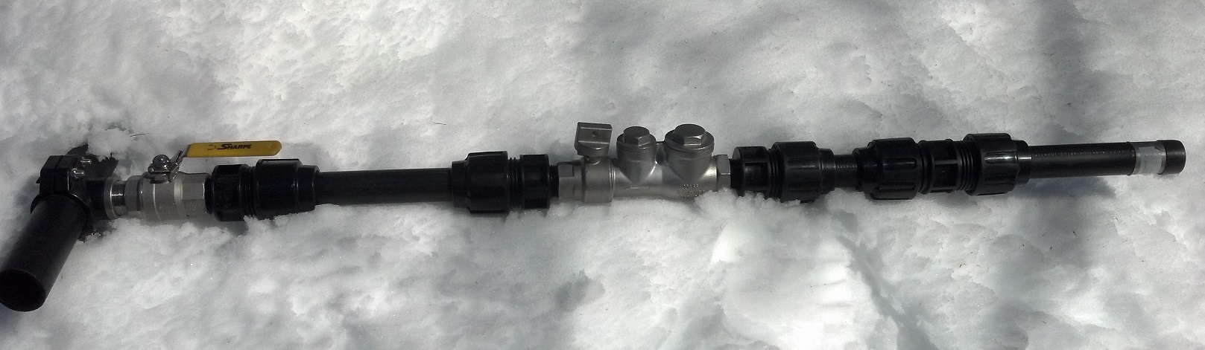
Discharge Pipe
Isolate connection to main line with corrosion resistant stainless steel corporation valve.
Isolate each lot/pump with full-port lateral stainless steel lateral assembly with shut off and sewage rated check valve.
Bed your lines with ¼” to ¾” pea gravel or crushed angular stone
The use of 1 ¼” Polyethylene Pipe SDR 11 or PVC SDR 21 are recommended. CAUTION SDR 21 PVC limitations in 1-1/4 inch to solvent glue only

Slide 31
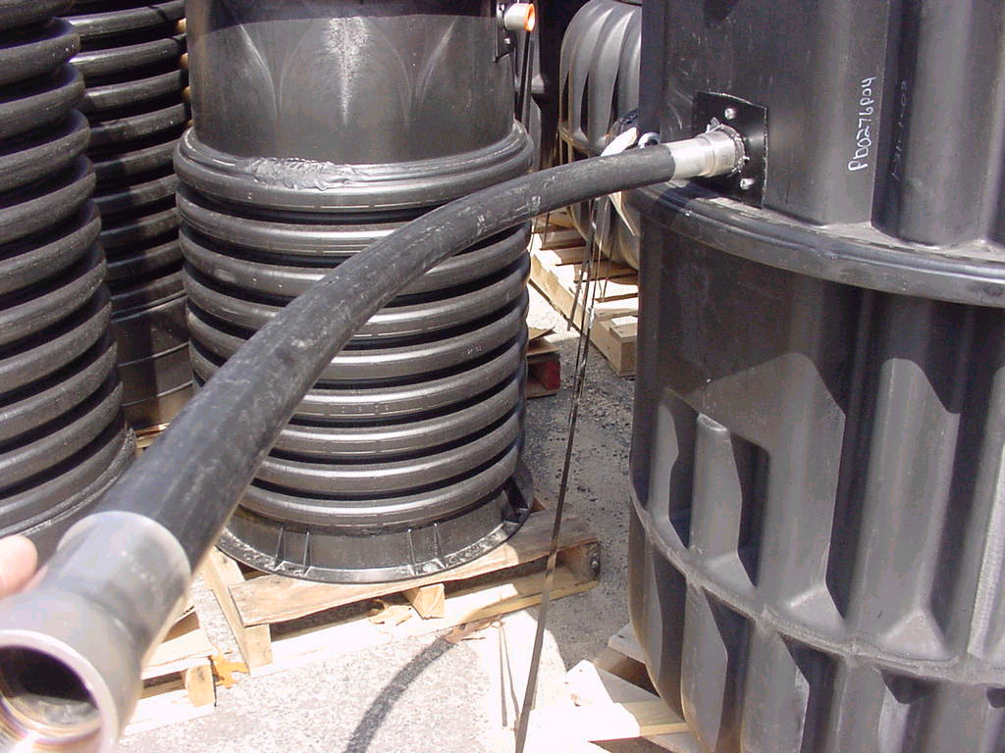
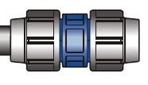
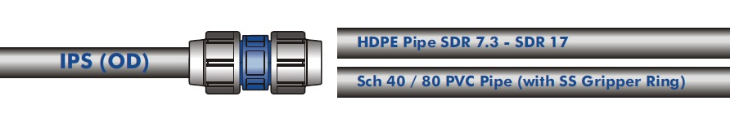
Discharge Pipe – Discharge Whip
FRMA provides a 4 foot long discharge whip of 1-1/4 inch SDR 11 HDPE pipe with SS MIPT on one end and plain end pipe on the other.
Also provided is a ‘compression’ coupling to connect to 1-1/4 or 1-1/2 inch lateral pipe (by others)

Slide 32
Station backfill requirements

Slide 33
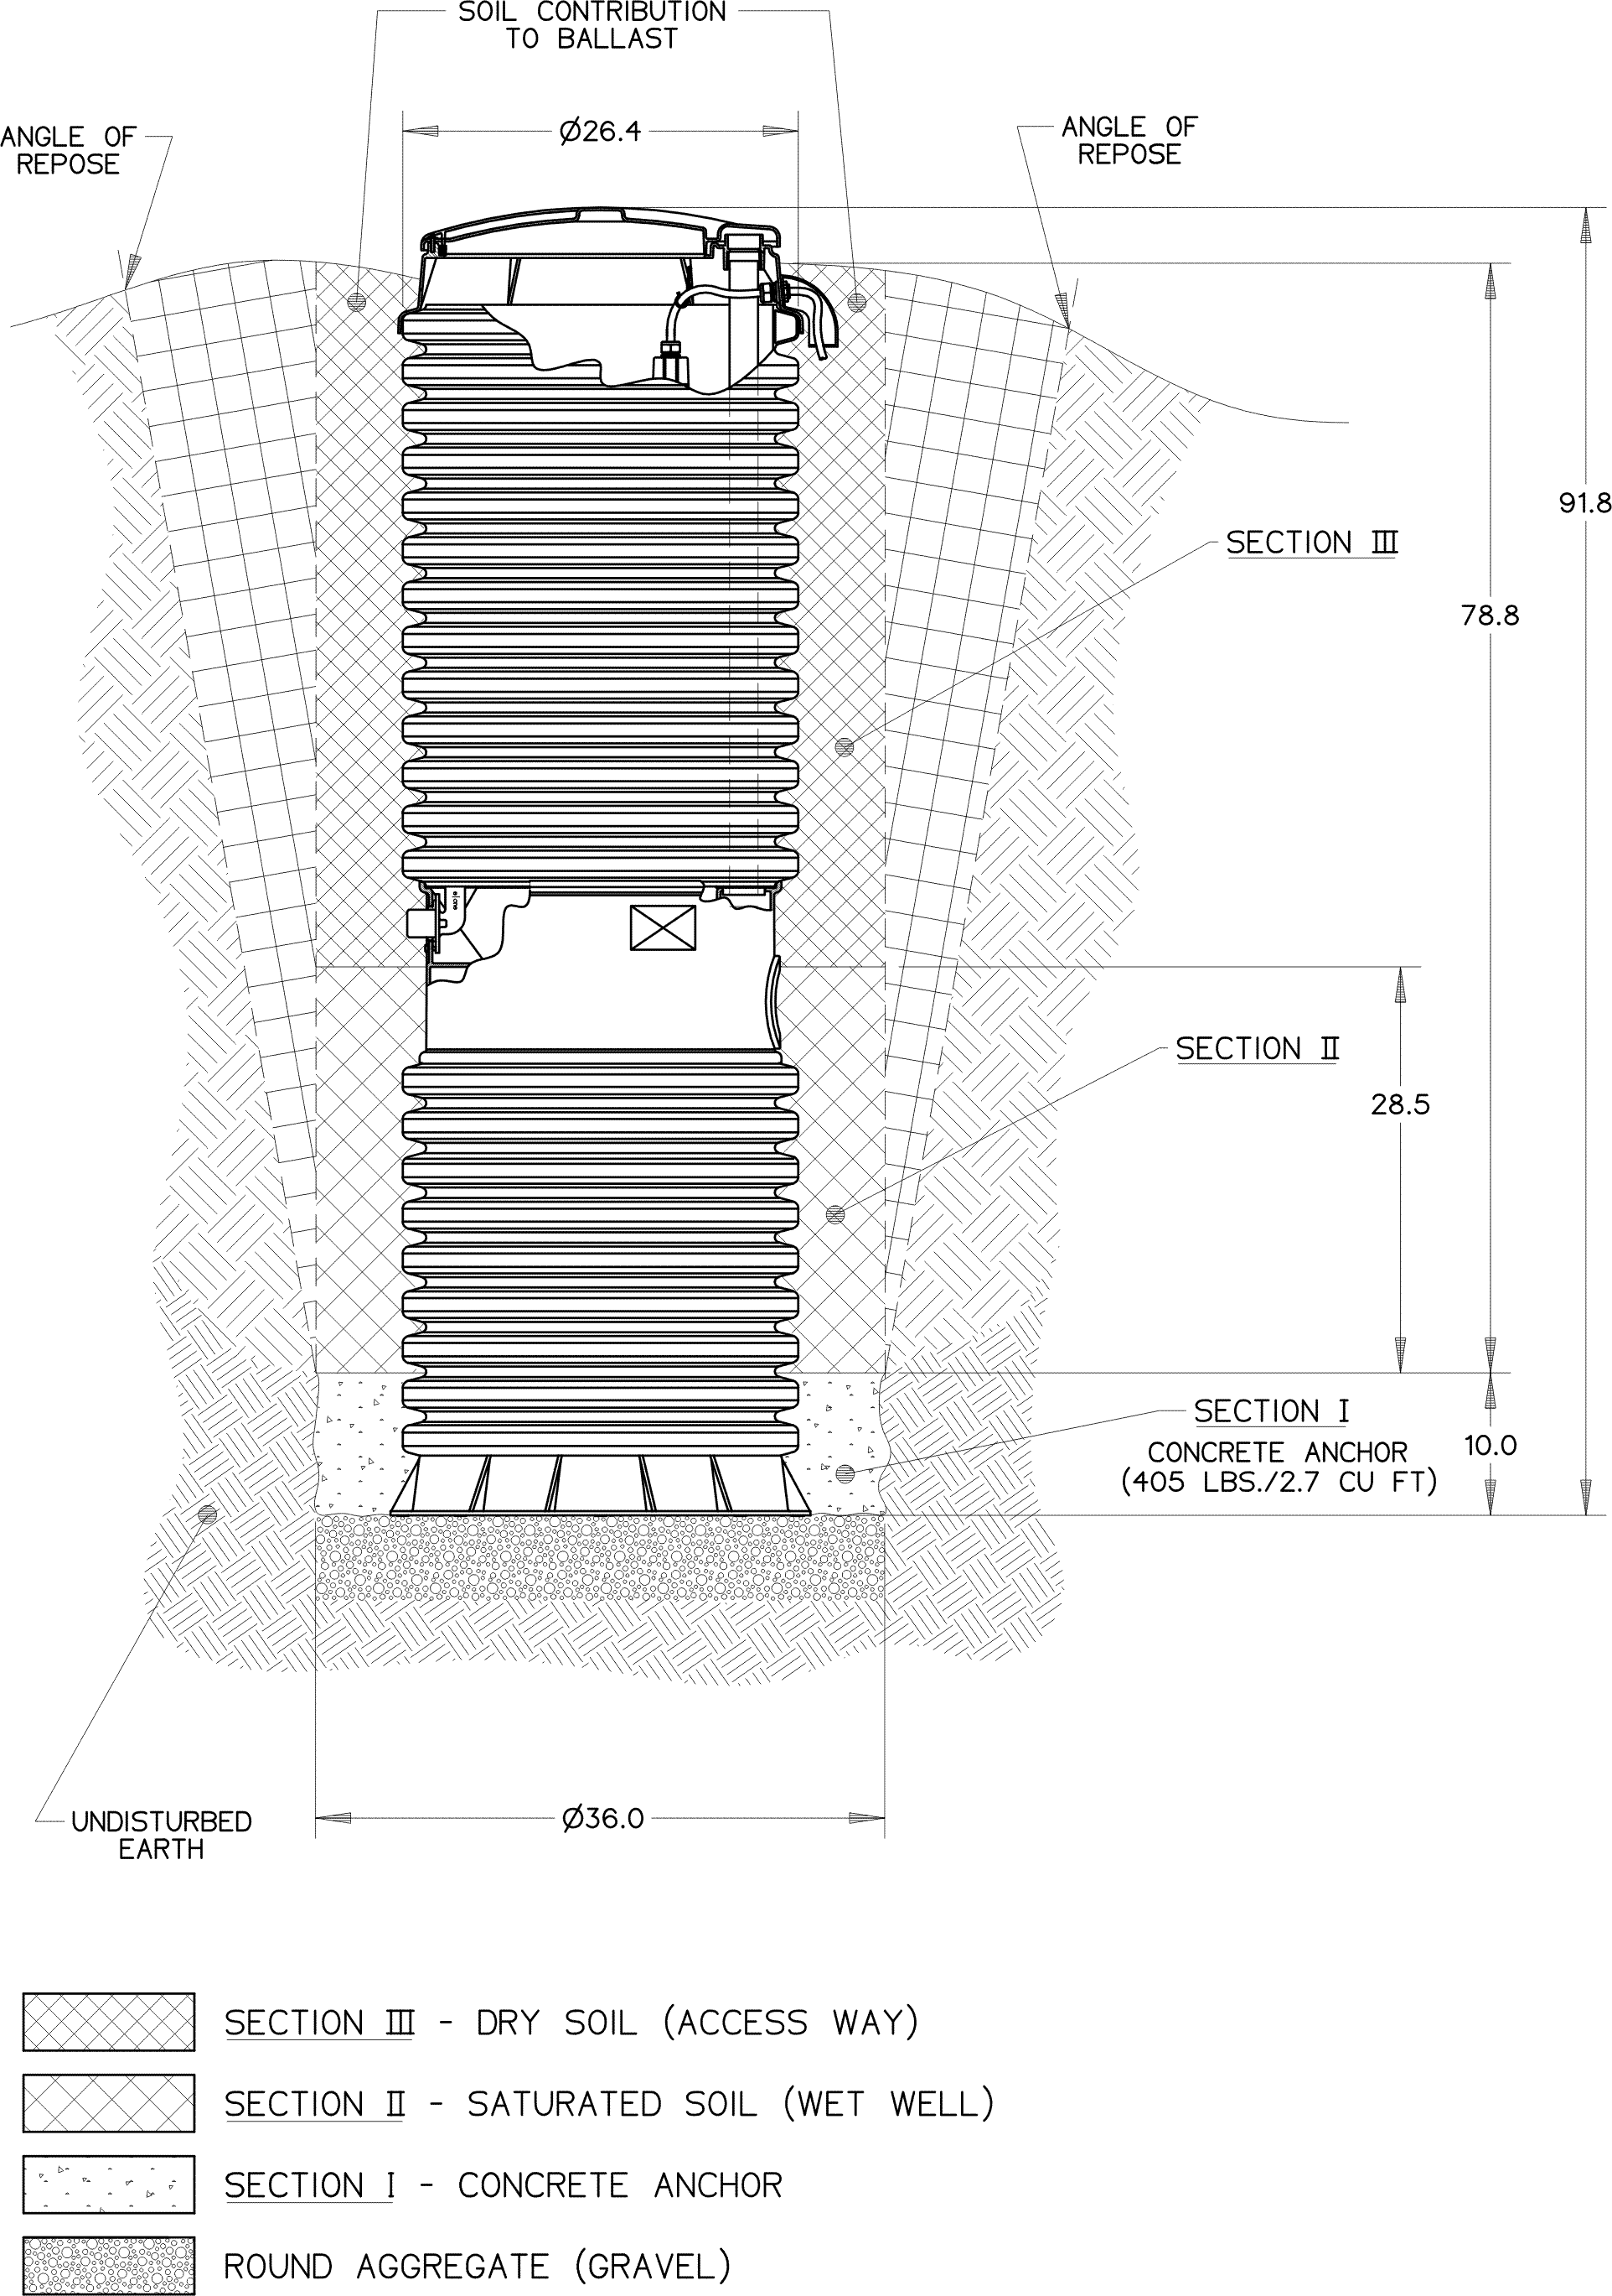
Backfill
The most highly recommended method of backfilling is to surround the unit to grade using Class I or Class II backfill material as defined in ASTM 2321
Compact backfill in 1’ lifts

Slide 34
Backfill
Class | Description
Class 1A and 1B | Recommended where frost heave is a concern
Class 1B | A better choice when the native soil is sand or if a high, fluctuating water table is expected
Class II (naturally rounded stone) | May require more compactive effort (tamping) to achieve the proper density. If the native soil condition consists of clean, compactable soil, with less than 12% fines, free of ice, rocks, roots, and organic material, it may be an acceptable backfill. Such soil must be compacted in lifts not to exceed one foot to reach a final Proctor Density of 85 to 90 percent.

Slide 35
Alternative Backfill
Another option is the use of a flowable fill (i.e., low slump concrete)
  This is particularly attractive when installing grinder pump stations in augured holes where tight clearances make it difficult to assure proper backfilling and compaction with dry materials
Flowable fills should not be dropped with more than four feet between the discharge nozzle and the bottom of the hole since this can cause separation of the constituent materials.

Slide 36
Station grading & height adjustment

Slide 37
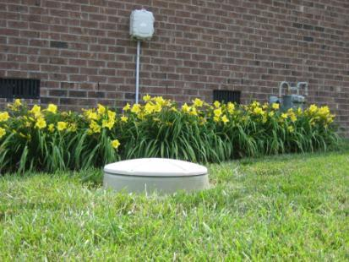
Proper Grade
Stations should be 1” to 4” above final grade with the ground sloping away from the station to provide proper venting and prevent infiltration of surface water, dirt, sand, etc.

Slide 38
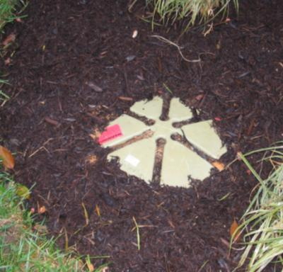
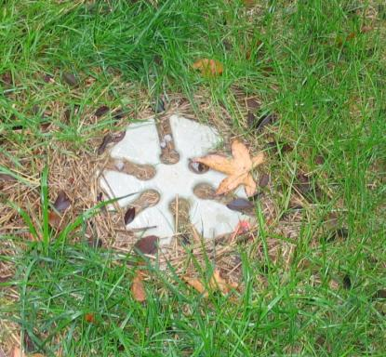
Improper Station height
Below Grade
Station is well below grade
Venting is restricted
Possible infiltration from surface water and dirt through the vents

Slide 39
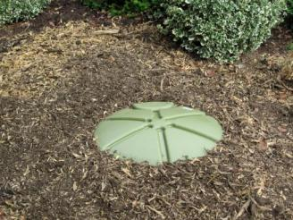
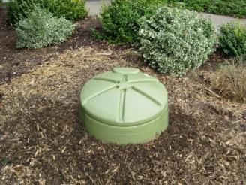
Height Adjustment
E/One Extender can be used where a 6-inch height increase is needed

Slide 40
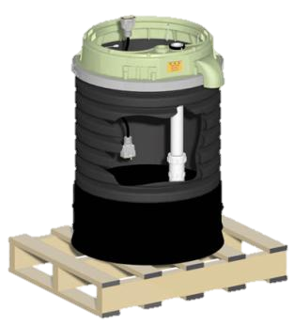
Height Adjustment
Station heights can be increased with 1, 2 and 4* foot risers and lowered in 3-inch increments
Risers can be trimmed in 3 inch increments to meet existing conditions
  * 4 foot risers can be used with limitations. Consult your dealer.
LIMITATIONS
Due to Structural Strength

Slide 41
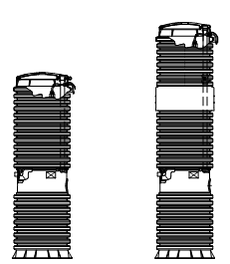
Height Adjustment
If a DH071 station was shipped from the factory as a -93 or less, the max height it can be extended to is 120”
If a DH071 station was shipped from the factory greater than 93”, the max height it can be extended to is 160”
LIMITATIONS
Due to Structural Strength

Slide 42
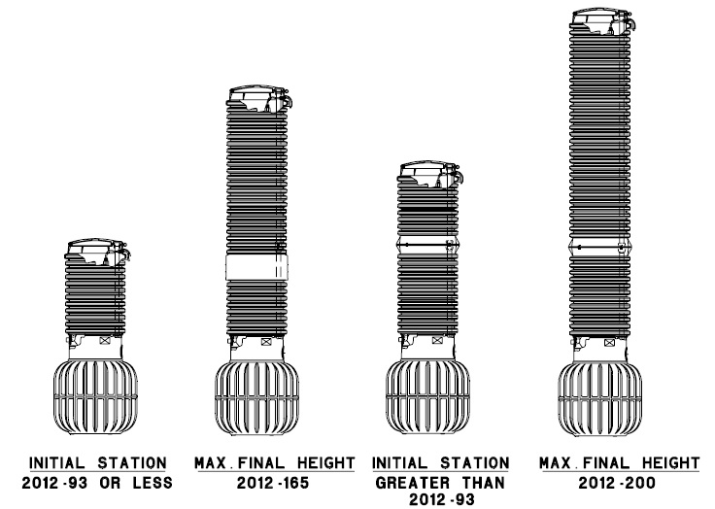
Height Adjustment
If a DH151 station was shipped from the factory as a -93 or less, the max height it can be extended to is 165”
If a DH151 station was shipped from the factory greater than 93”, the max height it can be extended to is 200”
LIMITATIONS
Due to Structural Strength

Slide 43
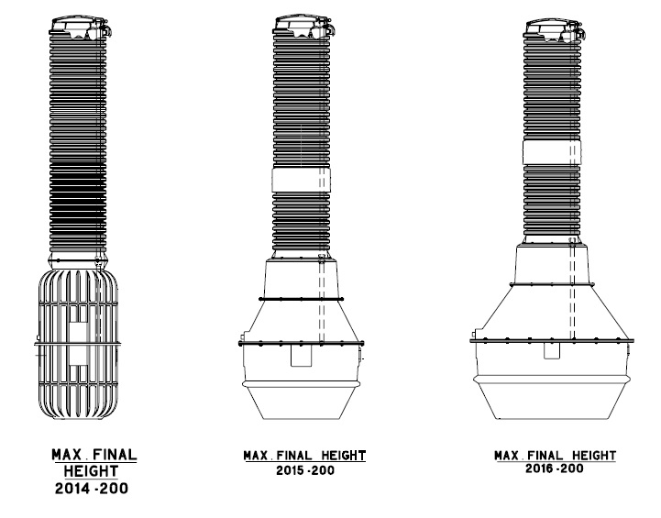
Height Adjustment
Regardless of the initial station height, the maximum height a duplex station can be extended is 200”
LIMITATIONS
Due to Structural Strength

Slide 44

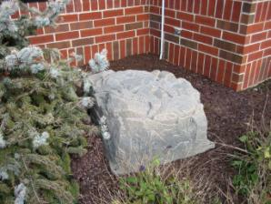
Decorative Rocks
Available in 2 sizes and 4 colors
  36” x 36” x 9”
  34” x 32” 15”
Vented
4 corner stakes hold rock in place

Slide 45
Ih091 – indoor unit
Estimated that 12 +/- homes may require indoor units or benefit from the use of indoor stations.
Placed in the basement floor in existing homes.
Can be set into basement floors for “whole house plumbing”

Slide 46
Ih091 – indoor unit
Massachusetts Plumbing Board accepted since 1996; as are all outdoor DH stations.
Standard warranty is 5 years
Basin has inlet knife valve for flow control and discharge true union, ball valve.
Basin is sealed and has connection for 2-inch vent
Inlet
  4-inch Socket Weld, SCHEDELE 40 is located 19-inches at centerline from the floor.
Discharge
  1-1/4 inch SCHEDULE 80 PVC is located approximately 37- inches from the floor.
  1-1/4 inch FIPT is left for connection.

Slide 47
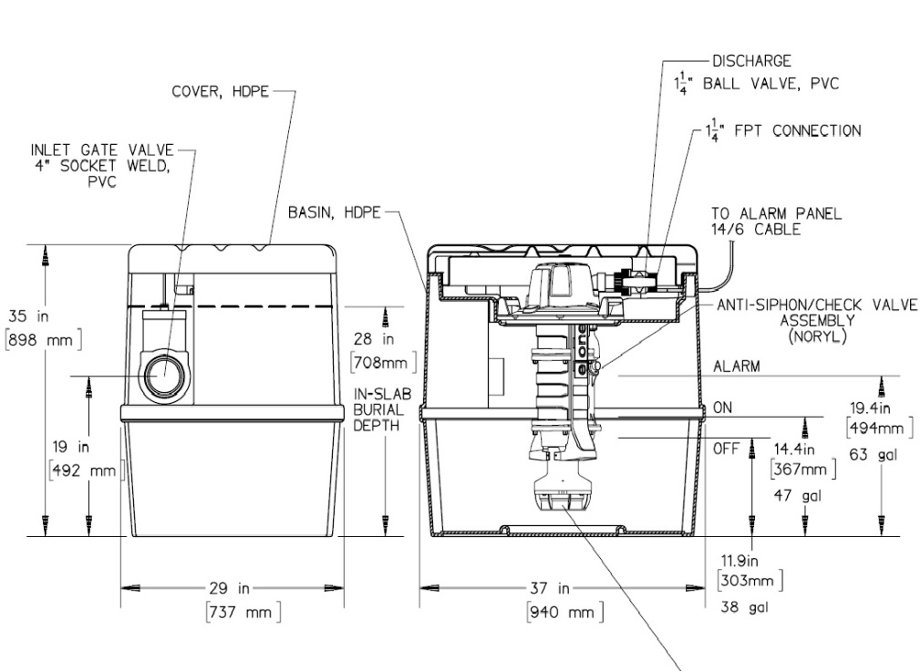
Ih091 – indoor unit dimensions
2-inch FIPT Vent Connection

Slide 48
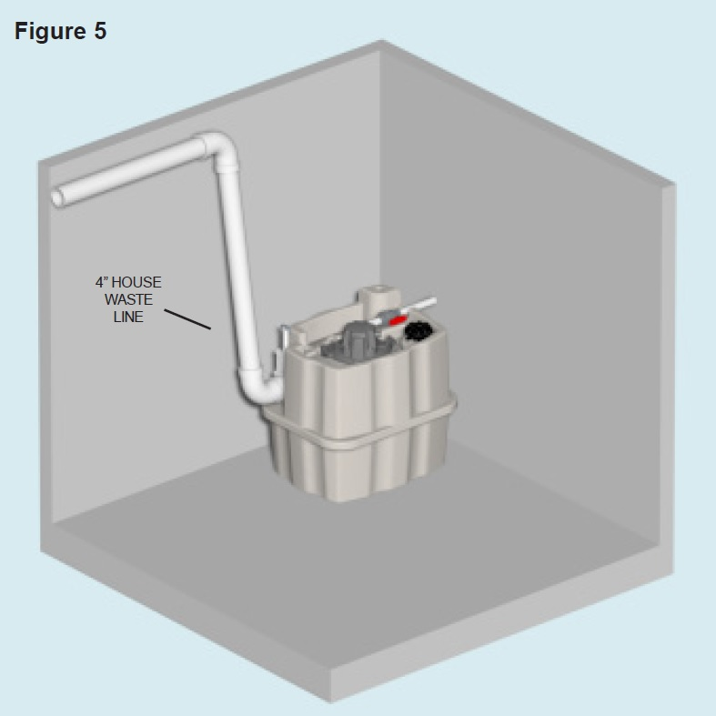
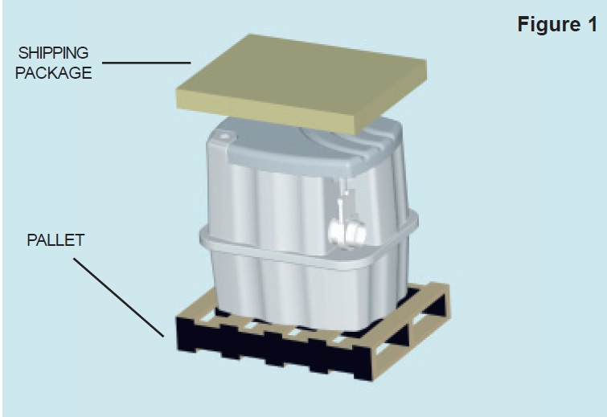
Indoor unit – tank and inlet piping

Slide 49
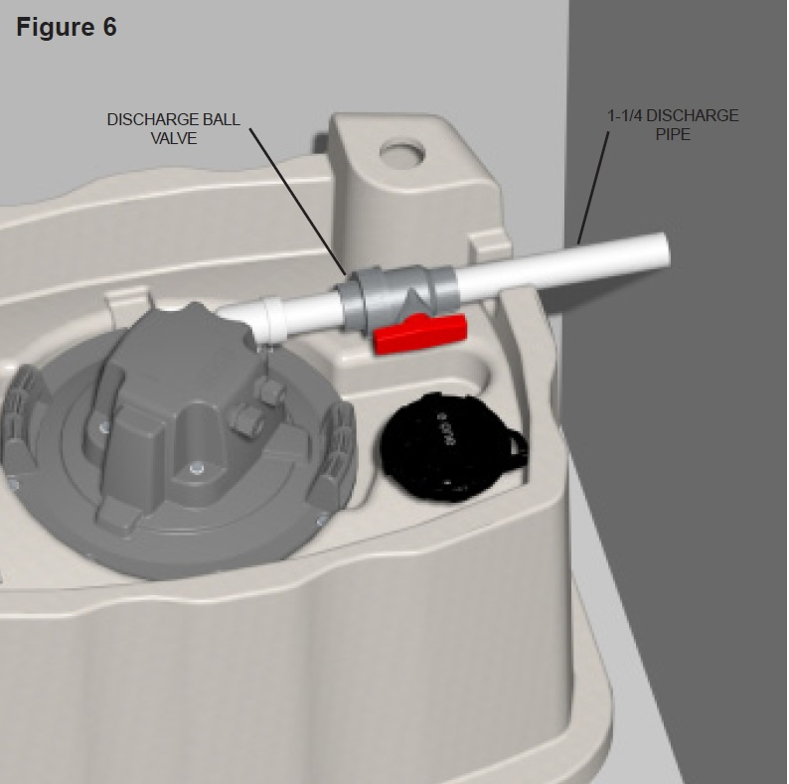
Indoor installation – discharge pipe
True Union Ball Valve (Provided)
  Install with ball valve facing the discharge side of line. (Allows stoppage of flow to isolated the pump and remove pump at union connection)
  Rotate valve so handle is facing the front of the tank and does not stick up. (Allows top cover to fit without hitting valve)

Slide 50
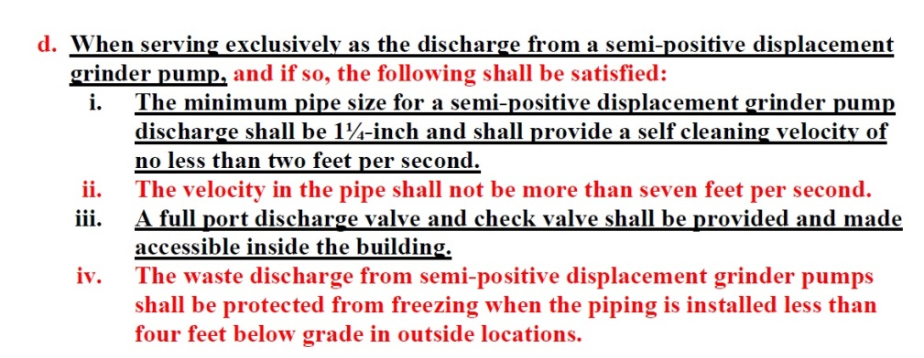
248 cmr 10.00
10.15 (7)(b)(1)(d) “Sanitary Piping Installed Through the Foundation Wall”

Slide 51
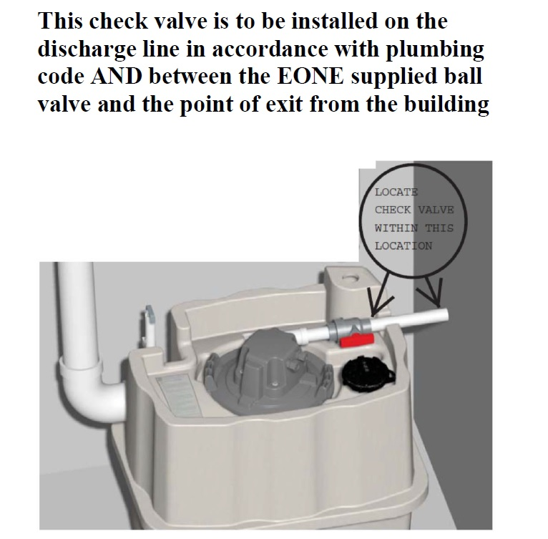
Interior check valve location
“Accessible” check valve location.
  Loose parts provided by FRMA
  To be installed by installing plumber

Slide 52
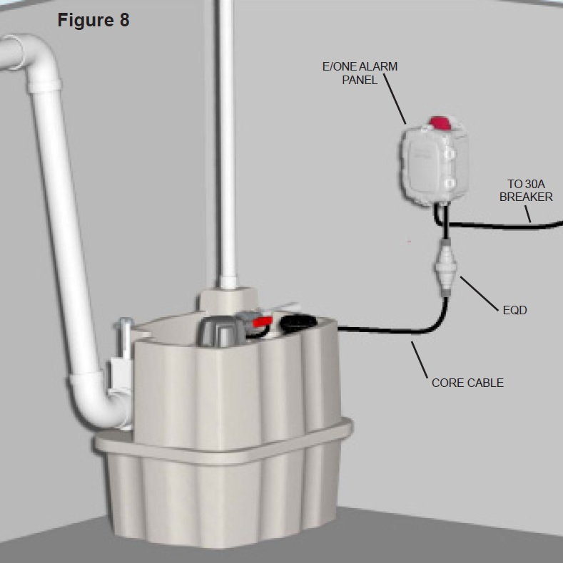
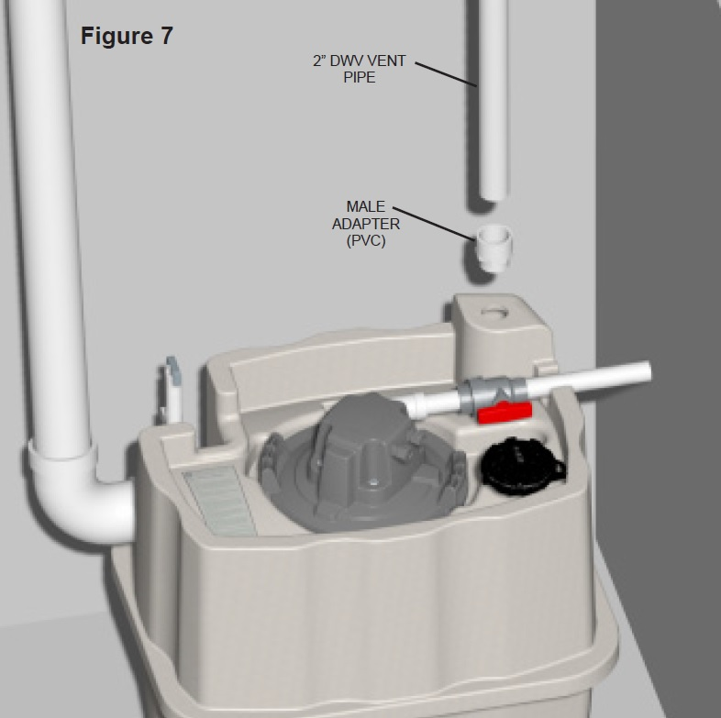
Indoor Installation
Tighten core bolts to seal core to tank

Slide 53
Electrical segment

Slide 54
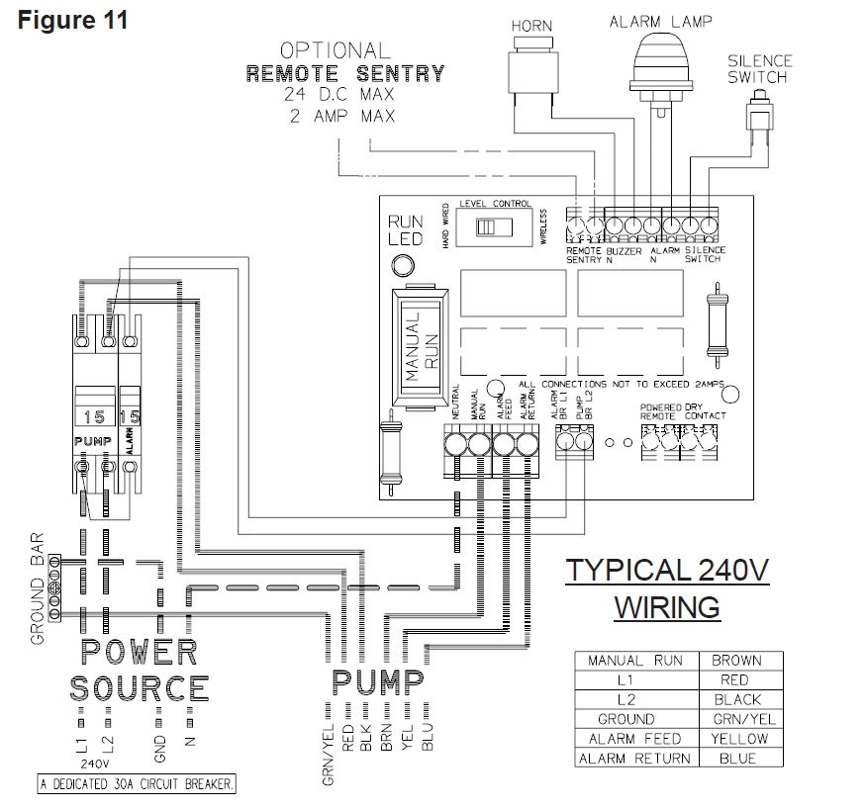
Indoor unit panel wiring
Connect Remote Sentry to “Remote Sentry Contacts” as shown. These contacts are able to provide switch closure even during power failure to enable the Remote Sentry Alarm to sound.
Switch Level Control to “wired” Position

Slide 56
Electrical – DH versus DR Series
Options listed in the online and print catalog for Environment One DH071/Dr071 stations. Which do you select?
The DH071 is the “hardwired” or “wired” model where a cable connects the motor controls to the level controls through watertight penetrations.
This is the standard model sold through FRMA.
This allows for the use of the optional “Remote Sentry’ battery powered, redundant, high level alarm module when provided in the scope of supply.
This feature is standard in the IH091 Indoor stations
The DR071 is the “radio frequency identification” (RFID). Or “wireless” model that uses wireless technology to communicate between the level controls and the motor controls.
This option is not promoted in our territory mainly due to the inability to have SODC Switch over dry contacts that operate in the “Wired” model to enable the use of the “Remoter Sentry” battery powered, redundant, high level alarm module.

Slide 57
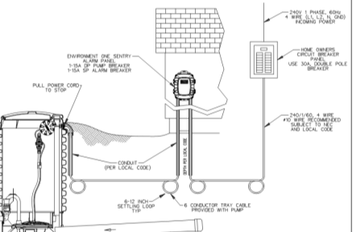
Electrical – Power supply
30 amp dedicated service is recommended.
For 240-Volt systems, 4 wires are required (L1, L2, Neutral & Ground
For 120-Volt systems, 3 wires are required (L1, Neutral & ground
120 volt systems are only recommended when power supply is limited. Systems are best operated with 240 volt power.
208 power supplies require Buck & Boost Transformer prior to the alarm panel

Slide 58

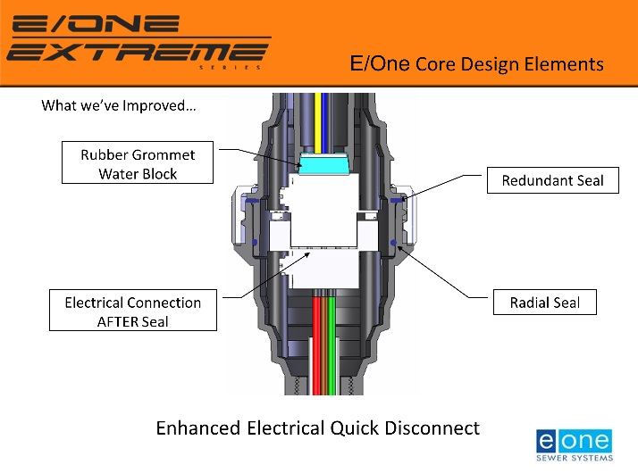
Overview
Electrical Quick Disconnect EQD
NEMA 6P connection
  Eliminates internal junction splice boxes
  Radial seal
Tool-free locking nut
  No Screws
Hangs at the top of the station

Slide 59
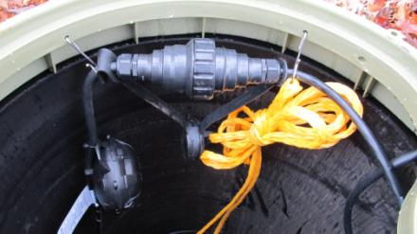
Overview
EQD & Equalizer
EQD & Equalizer must be hung at the top of the station
Easy access to pump and power supply cable eliminates confined space entry requirements

Slide 60
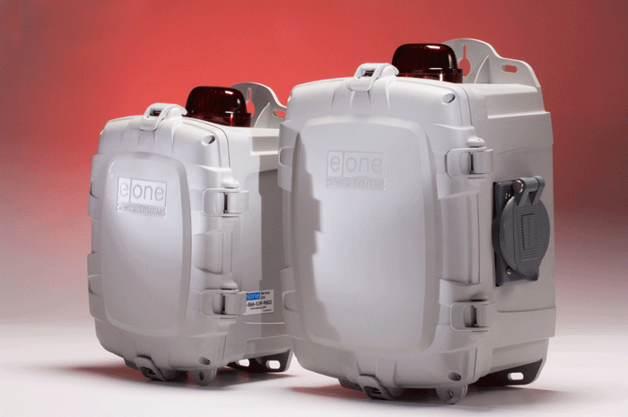
Overview
Alarm Panels
  Simplex and Duplex Panels
  Audible Alarm (Buzzer)
  Audible Alarm Silence Switch
  Visual Alarm (Red Light)
  Redundant Run (In Alarm)
  Remote Sentry Contacts (FRMA)
  Options:
    Emergency Generator Capabilities
    Remote Sentry Batter Powered Alarm
    Protect and Protect Plus Panels
    Sentry Advisor Remote Monitoring
240-Volt, Single Phase power required.
Environment One offers a wide variety of alarm panels with multiple options

Slide 61
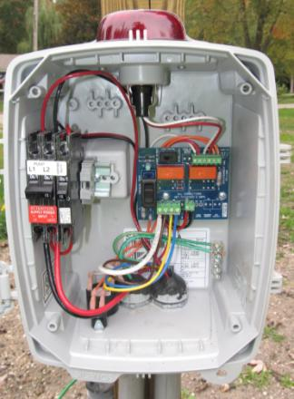
Overview
Alarm Panels
  Manual Run Switch
  Circuit Breakers
  Audible Alarm (Buzzer)
  Audible Alarm Silence Switch
  Visual Alarm (Red Light)
  Redundant Run (In Alarm)
  Remote Sentry Contacts (FRMA)
Simplex Panel Standard Functions

Slide 62
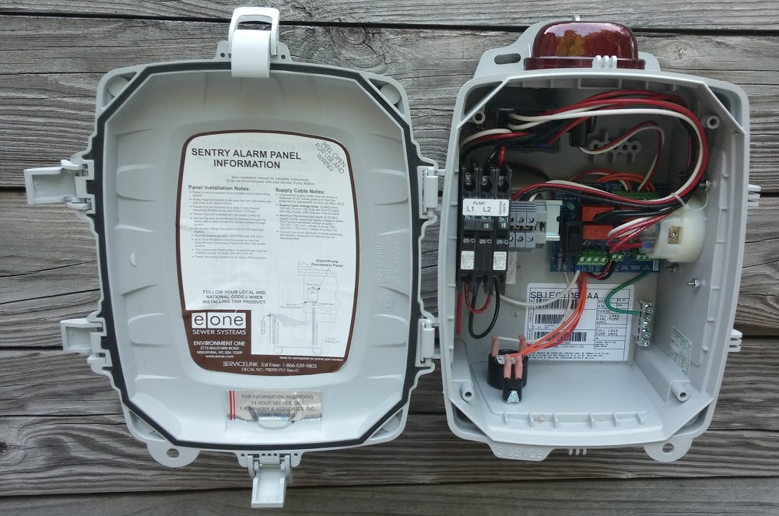
Overview
Alarm Panels
Dry Contacts
Powered Contacts
  Hour Meters
  Generator Receptacle with Auto Transfer Relay (shown)
  Dead Front
  GFCI Outlet
  Main Service Disconnect
Simplex Panel Optional Functions
Environment One offers a wide variety of alarm panels with multiple options

Slide 63

Overview
Alarm Panels
Full Motor Protection
  Brown Out
  Closed Valve
  Run Dry
  Extended Run protection
  Frequent starts/stops
Complete station Monitoring
  Alarm and trouble conditions.
  Digital Display and programming
Remote access to live and historical operating conditions
  Cellular connection to secure website
  Pump Run Cycles
  Run Times
  Alarm notifications
    Local light and buzzer
    Text, Phone, email,
Simplex Protect and Protect Plus Panels

Slide 64

Overview
Alarm Panels
  Circuit Breakers
  Audible Alarm (Buzzer)
  Visual Alarm (Red Light)
  Audible Alarm Silence Switch
  Manual Run Switches
  Lead/Lag or Both Operation
  Lead/Lag, Run, & Alarm Indicator LED’s
  Dry Contacts
T-260 Duplex Panel Standard Features
Time based alternating panel

Slide 65
Overview
Alarm Panels
GFCI
Hour Meters
Generator Receptacle with Auto Transfer Relay
Dead Front
Main Service Disconnect
Sentry Advisor Remote Monitoring
T-260 Duplex Optional Features

Slide 66

Overview
Alarm Panels
Full Motor Protection
  Brown Out
  Closed Valve
  Run Dry
  Extended Run protection
  Frequent starts/stops
Complete station Monitoring
  Alarm and trouble conditions.
  Digital Display and programming
Remote access to live and historical operating conditions
  Cellular connection to secure website
  Pump Run Cycles
  Run Times
  Alarm notifications
    Local light and buzzer
    Text, Phone, email,
Simplex & Duplex Protect Plus with Sentry Advisor

Slide 67

Alarm panel
Sentry Protect Panel
Full Motor Protection
  Brown Out
  Closed Valve
  Run Dry
  Optional Features included.
    Generator Receptacle and Automatic Transfer
    Remote Sentry redundant alarm panel

Slide 68

– Alarm panel
Sentry Protect Panel
Full Motor Protection
  Brown Out
  Closed Valve
  Run Dry
  Optional Features included.
    Generator Receptacle and Automatic Transfer
    Remote Sentry redundant alarm panel

Slide 69

– Alarm panel
Sentry Protect Panel
Full Motor Protection
  Brown Out
  Closed Valve
  Run Dry
  Optional Features included.
    Generator Receptacle and Automatic Transfer
    Remote Sentry redundant alarm panel

Slide 70

Wiring instructions
Supplied in Installation instruction booklet inside the access cover of every pump.
  Generic to basic panel
  Use 240-volt diagram for pumps to be supplied as standard.
    Typical standard in N.E.
    120-Volt systems are very rare.
Inside the alarm panel door. Peel back label that has specific wiring instructions.

Slide 71


Panel Wiring line power

Slide 72

Protect Panel – Pump cable connections

Slide 73

Electrical – Power supply
208 Power supply systems require a Buck & Boost Transformer
FRMA can supply units for this.
Transformer must be located near the power supply prior to the alarm panel feeder
Typical uses are commercial buildings or schools that may be supplied with 208 power supplies.
Measure voltage once installed. Higher power leg should go to the pump load leg and NOT to alarm jumped leg.

Slide 74

Electrical – Cable & conduit
Use only the cable provided
Do not splice underground cables
Standard length is 32 feet
  Additional lengths available – 50, 75 and 100 feet
Cable is NEC rated for direct burial.
We recommend cable to be installed in conduit whenever possible

Slide 75
Electrical - Conduit
Conduit must be installed for the vertical rises to the access cover and to the alarm panel.
A minimum of 2’ of coverage is required per NEC
6- to 12-inch vertical settling loops required at bottom of each vertical riser for direct bury.
FRMA recommends cable to be installed in conduit
  Cable is NEC rated for direct bury
  Consult local codes and wiring inspectors for additional limitations

Slide 76


Electrical – tank connections
Pull all of the cable out of the station until you reach the stop
Tighten the Liquid Tight Cord Grip
Install the cable shroud on HDPE stations
Do Not penetrate the basin with conduit – Use provided tank penetration and cord grip

Slide 77

Cable Penetration
Conduit ends under cable shroud (provided)
Do NOT make penetrations in the tank
Tighten cord grip to assure watertight penetration.
Verify that cord grip nut and O-ring are secure on inside of tank.
Verify that EQD is securely tight and hanging in the proper position.

Slide 78

Panels – rating & location
All stations are provided with a NEMA 4X alarm panel
Minimum mounting height of 36 inches
Alarm panels must be located within sight of the pump, mounted on the building or on a suitable pole

Slide 79
Panels - wiring
Wire Alarm panel following the provided instructions located on the inner panel door
Failure to follow wiring instructions will void warranty
Instructions include:
  Panel height and location
  Proper Panel Penetration
  Correct Wiring Orientation
  Power feeder, size and amperage requirements

Slide 80

Panels - wiring
Pump Power L1 & Pump Power L2
Hard Wired / Wireless switch in correct position
Panel mounted securely 4’ to 5’ off of the ground
Manual Run, Alarm Feed, Alarm Return in correct terminal
Four wires from source: L1, L2,
Neutral (white wire) & Ground
Bottom penetrations only and conduit sealed with duct seal

Slide 81

Improper panel installation
Panel is penetrated in the back for source power
  Potential leak path
Conduit is not sealed
  Possible moisture and insect pathway

Slide 82
Panels – Remote Sentry
Remote Sentry Option for alarm during normal and power loss. Sold standard for models IH091 indoor units and standard for DH stations .

Slide 83

Panels – Remote Sentry
Remote Sentry Option for alarm during normal and power loss. Sold standard for models IH091 indoor units and standard for DH stations.

Slide 84



Panels – Remote Sentry
Battery replacement (4) CR2032

Slide 85
Remote sentry - features
Provides redundant alarm for homeowner when the station has power or when power is out
Provides additional alarm in living space that can be heard by residents.
Drop down door allows access to silence and test buttons as well as user instructions during power loss.
Silencing this panel will not silence the Sentry Protect Panel. This is done separately.
Requires the electrician to wire the unit in the home.
Requires 18-22 gauge “door bell’” type twisted pair wire.
  100 feet supplied with IH091 standard
Requires that the internal battery be changed on routine basis to be functional.
  Change batteries at daylight savings time when you change batteries in smoke and CO2 detectors.
  Battery replacement (4) CR2032 available at local hardware stores

Slide 86

Not so remote sentry

Slide 87
Start up inspection
Mandatory for all stations
Failure to call for or pass inspection may void the warranty
Last opportunity to make corrections to avoid unnecessary service calls.
Inspections provides for more reliable system operation and consumer confidence.
This is a team effort.
You do not get a discount or credit for avoiding a startup.
You may be charged extra for repeated inspections if corrections are not made in timely manner. While rare, this can occur in some cases.
We are here to work with and for you. We simply ask for your cooperation to make all installations successful.

Slide 88

Startup inspection
Call 508-765-0051 at least 24 hours in advance to schedule startup inspection.
Startup is included in the cost of pumps sold through FRMA
Installers must call 24 hours in advance to schedule
  Power is connected
  Discharge is connected
  Available sewage flow or water supply
  Station is backfilled and ready for use
    Backfill, wiring and pipe inspections are performed locally to meet local codes
Inspection reports are sent to the owner or installer with acceptance or deficiencies
  Repeat inspections may be subject to additional charges
  Emergency service calls may take precedence over startup inspections

Slide 89

Startup inspection
Startup is included in the cost of pumps sold through FRMA
Installers must call 24 hours in advance to schedule
  Power is connected
  Discharge is connected
  Available sewage flow or water supply
  Station is backfilled and ready for use
    Backfill, wiring and pipe inspections are performed locally to meet local codes
Multi-point inspections
  Some communities require copies prior to sign off of sewer connection permits.
Call 508-765-0051 at least 24 hours in advance to schedule startup inspection.

